Slide 1
GNR-602 PROJECT
Spectral unmixing using K-Means and Fully Constrained Least squares (FCLS):
Group no.: 16
JOEL ANTO PAUL- 210070037
KRISHA SHAH- 21d070039
SHRAVANI KODE- 210070082

Slide 2
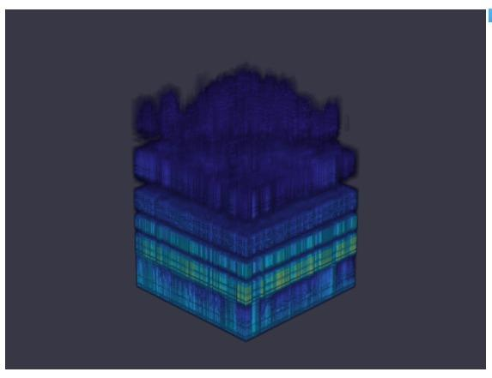
Hyperspectral Imaging
Hyperspectral imaging (HSI) is a technique that analyzes a wide spectrum of light instead of just assigning primary colors (red, green, blue) to each pixel.
The narrowness and contiguous nature of measurements makes it hyperspectral.
We collects many individual images of a scene, each taken within a different narrow wavelength band. The result is a "data cube" of the combined images.
Data Cube

Slide 3
What is Spectral unmixing?
Decomposition of a pixel spectrum into its constituent spectra
Spectra of the pure materials, called endmembers, as well as their abundances in each pixel, are considered unknown
The algorithm performs following tasks:
Endmember extraction :Finding the unknown endmember spectra
Unmixing: Determining the corresponding abundances of each endmember in each pixel

Slide 4
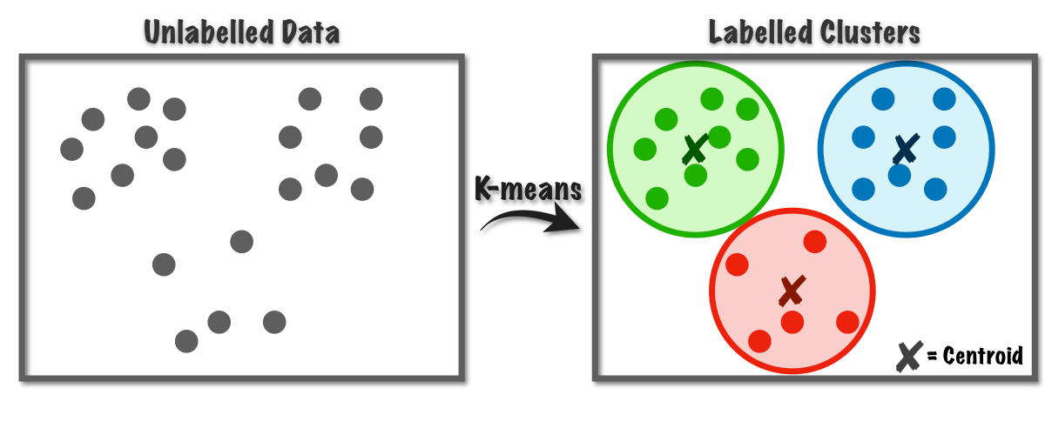

K-MEANS CLUSTERING
k-Means clustering algorithm is used to detect the homogeneous regions in the image
We initialize Θ randomly and report the results of the one that minimizes the cost function J of k-Means for different values of m.
We use Squared Euclidean distance and Canberra distance

Slide 5
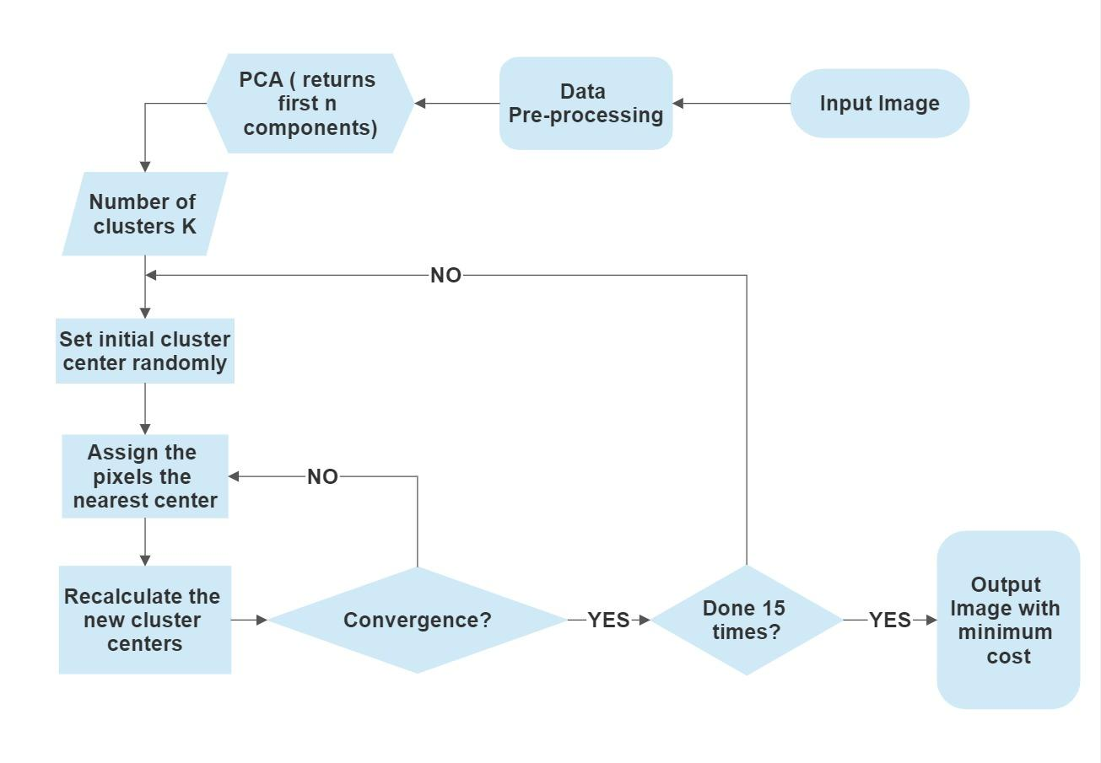
K-MEANS CLUSTERING

Slide 6
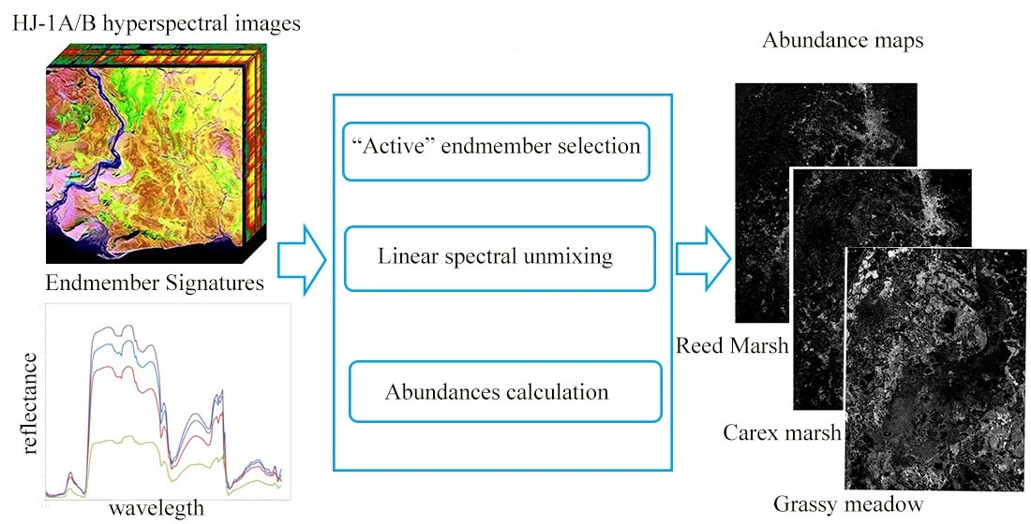
Fully Constrained Least-squares (FCLS) Linear Unmixing
Fully constrained least squares is least squares with the abundance sum-to-one constraint (ASC) and the abundance nonnegative constraint (ANC).
Involves iterative computations to generate a nearly optimal solution.
It requires a maximum of p - 1 iterations and terminates when no more steering is required.
Reference:https://ieeexplore.ieee.org/stamp/stamp.jsp?tp=&arnumber=774644

Slide 7

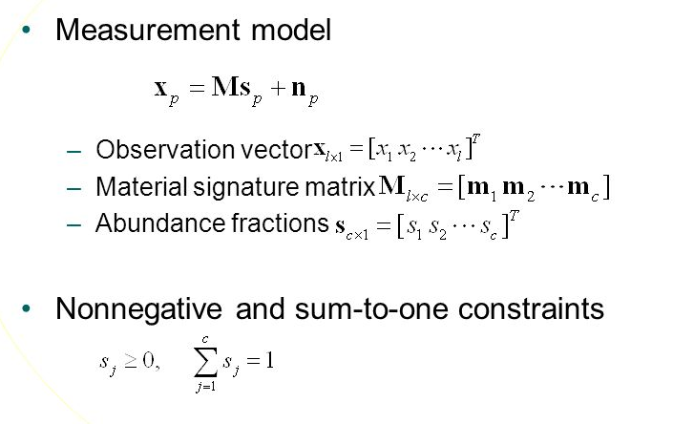


Fully Constrained Least-squares (FCLS) Linear Unmixing

Slide 8
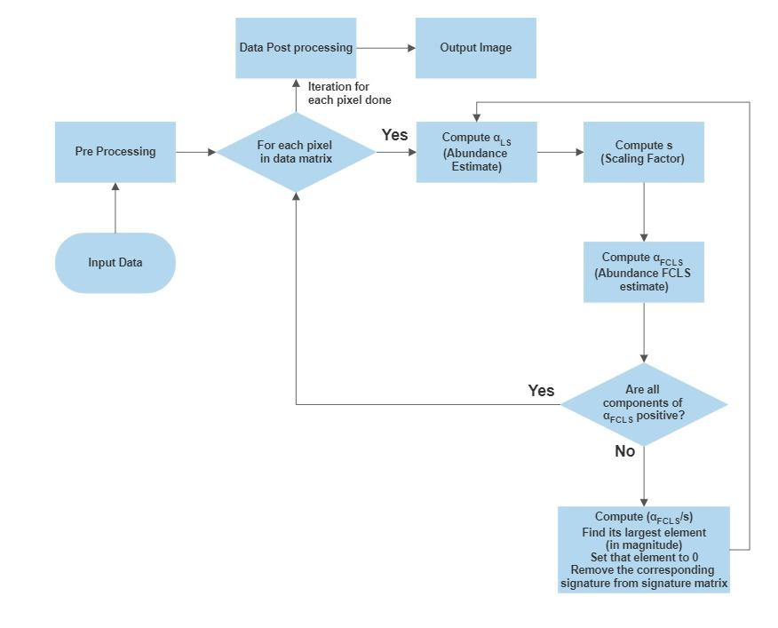
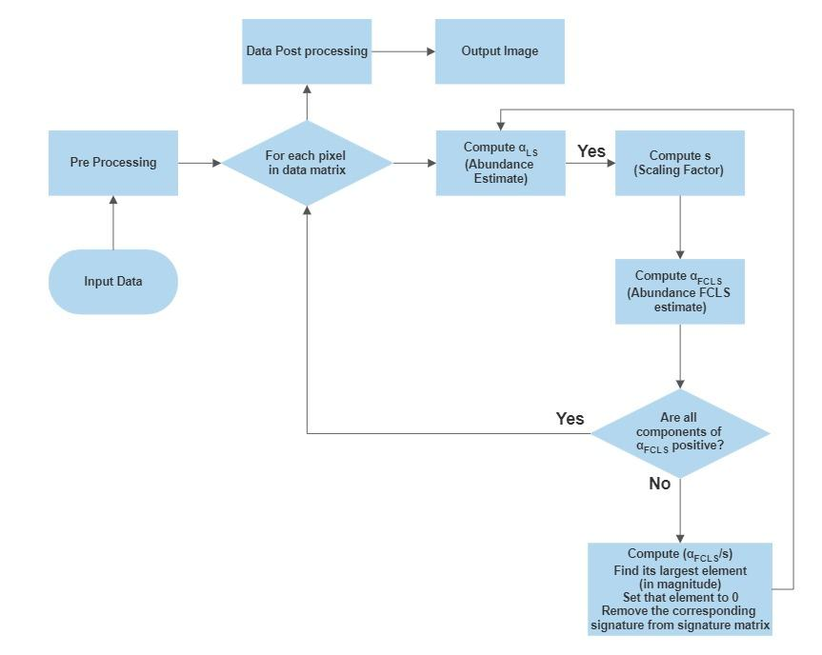
Fully Constrained Least-squares (FCLS) Linear Unmixing

Slide 9
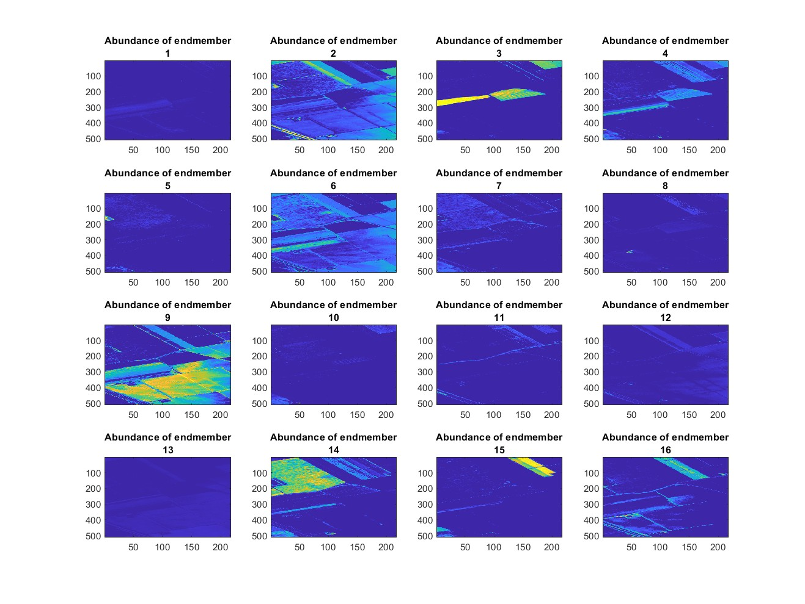
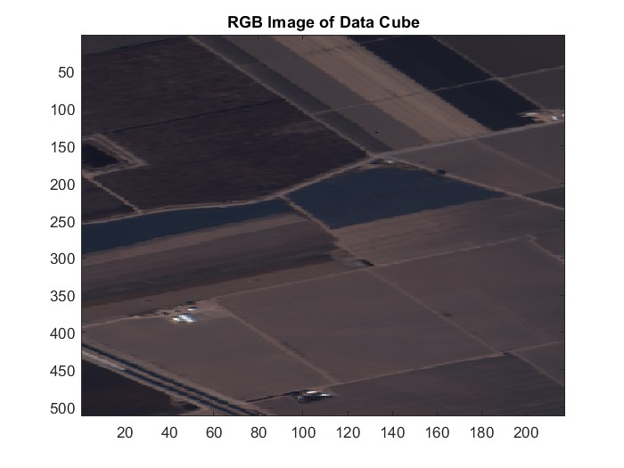
RESULTS (SALINAS)
End members
RGB Image

Slide 10
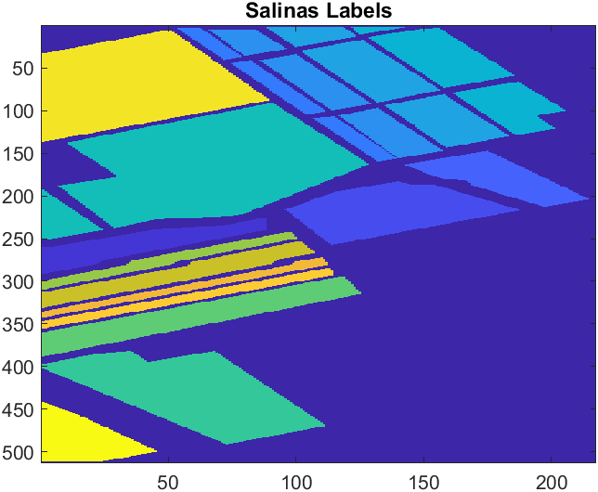
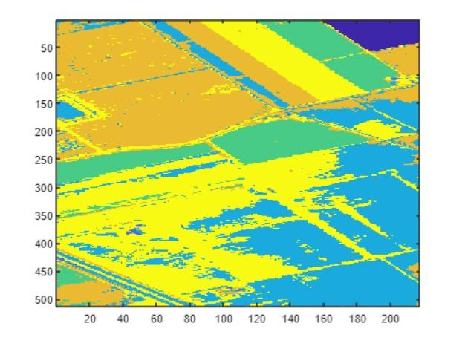
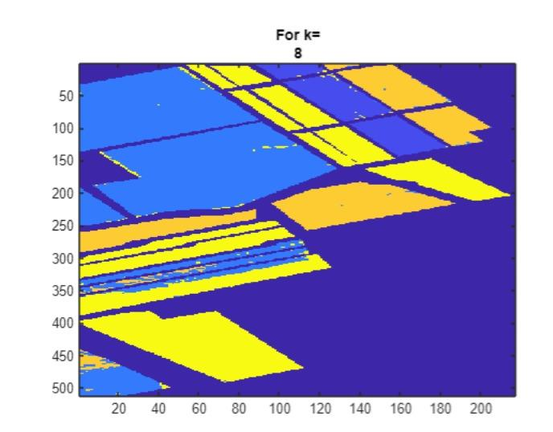
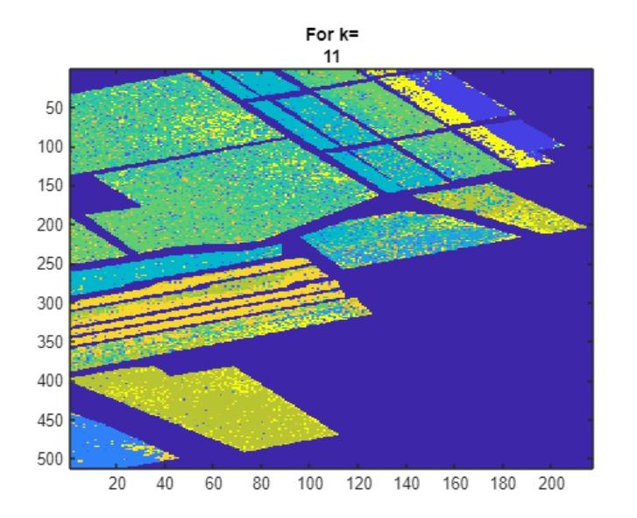
Ground truth
Predicted from FCLS
K-means
( euclidean distance)
K-means (Canberra distance)

Slide 11
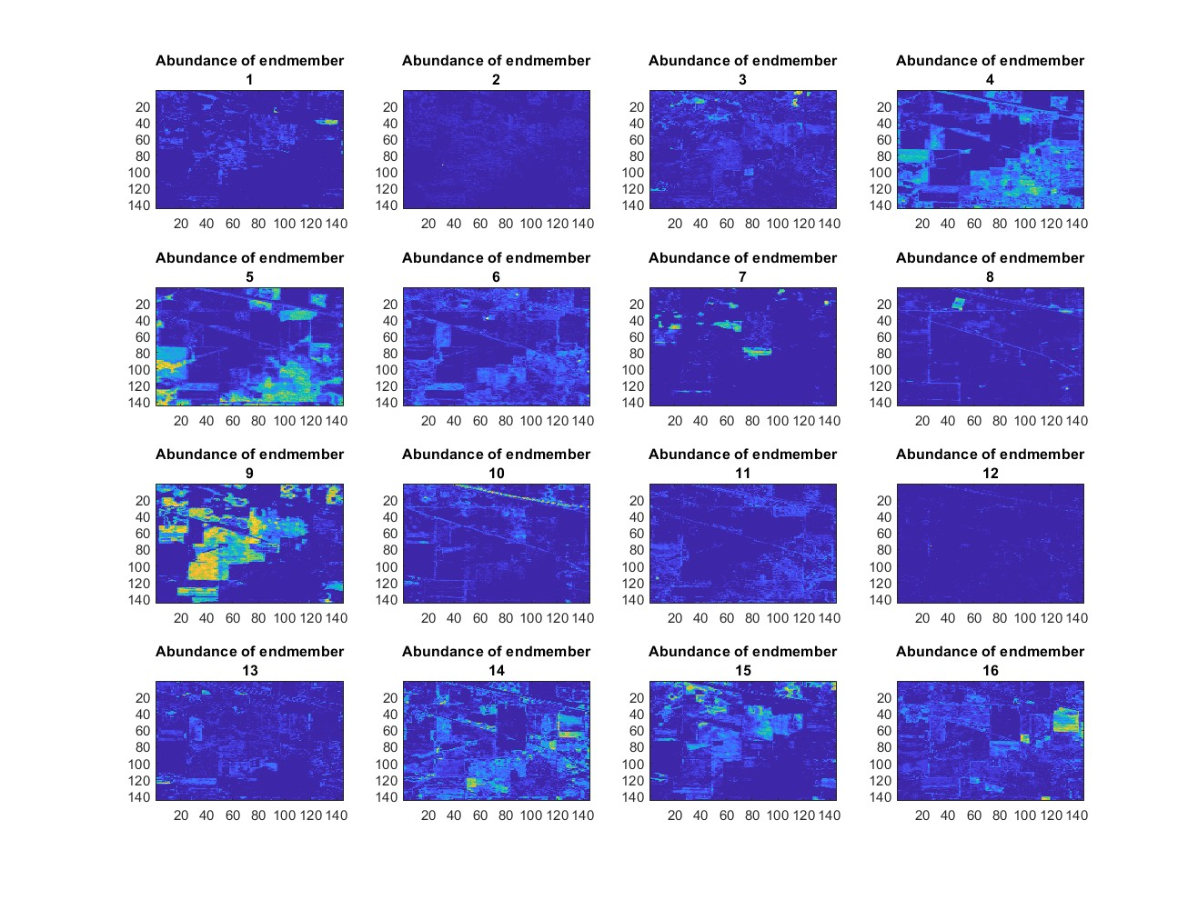
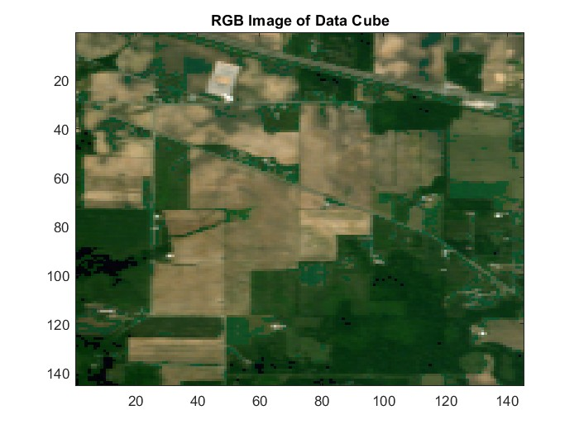
RESULTS (INDIAN PINES)
End members
RGB Image

Slide 12
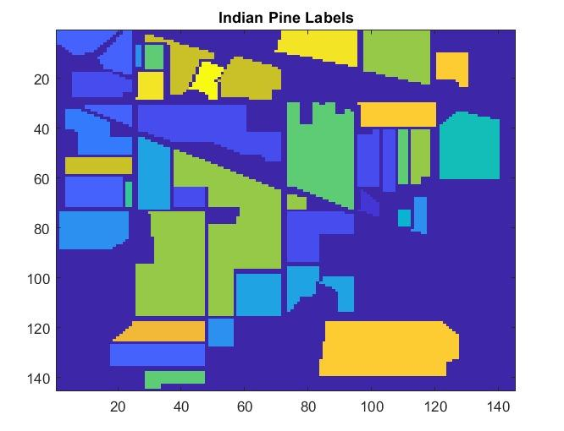
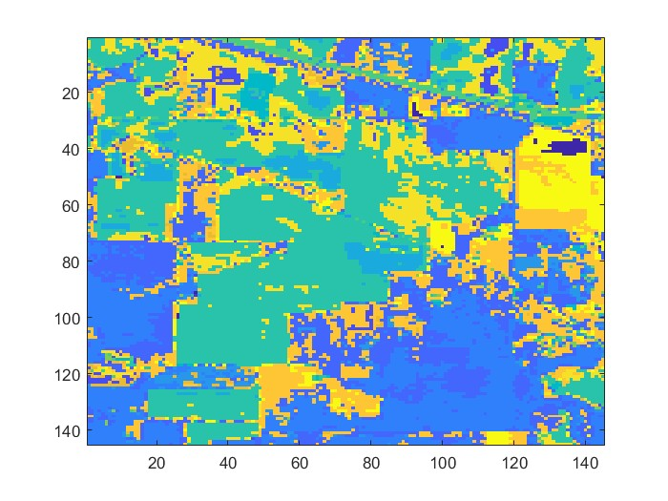
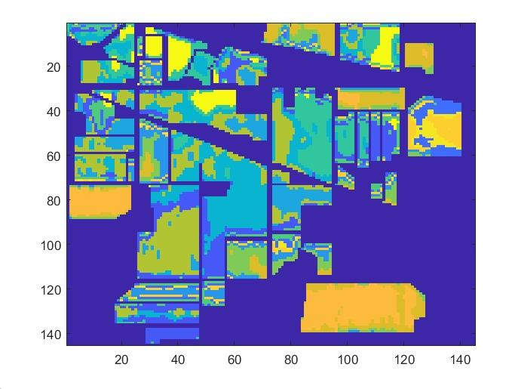
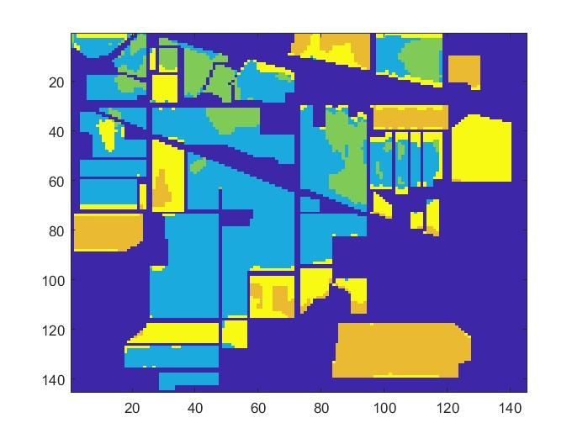
Ground truth
Predicted from FCLS
K-means
( euclidean distance)
K-means (Canberra distance)

Slide 13
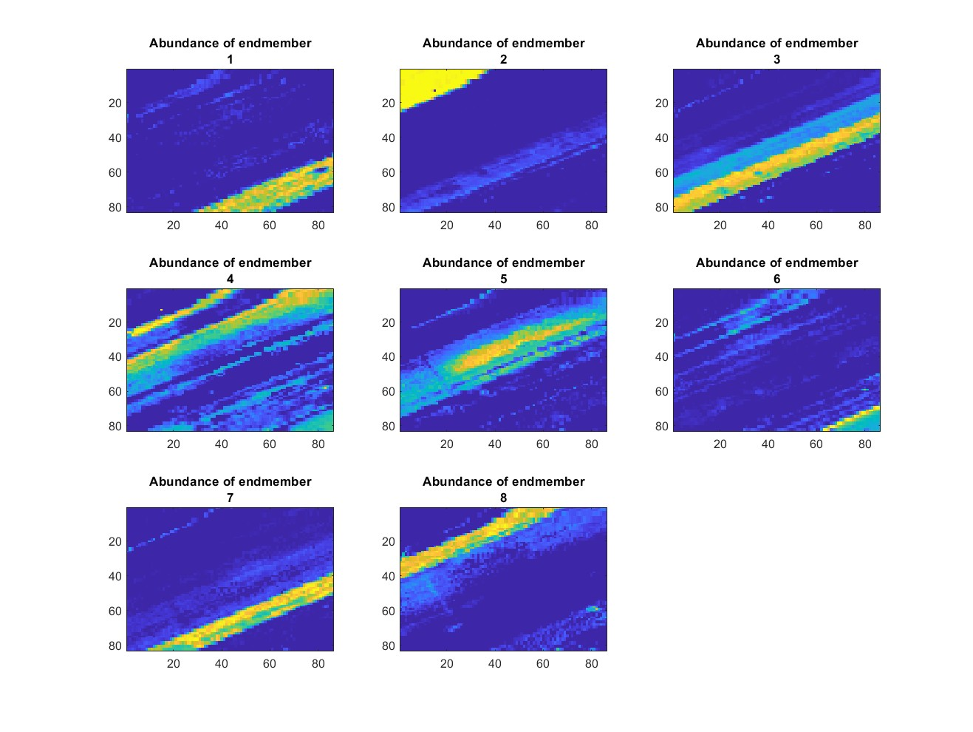
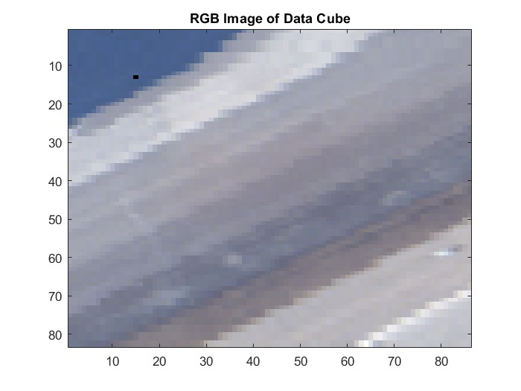
RESULTS (SALINAS-A)
End members
RGB Image

Slide 14
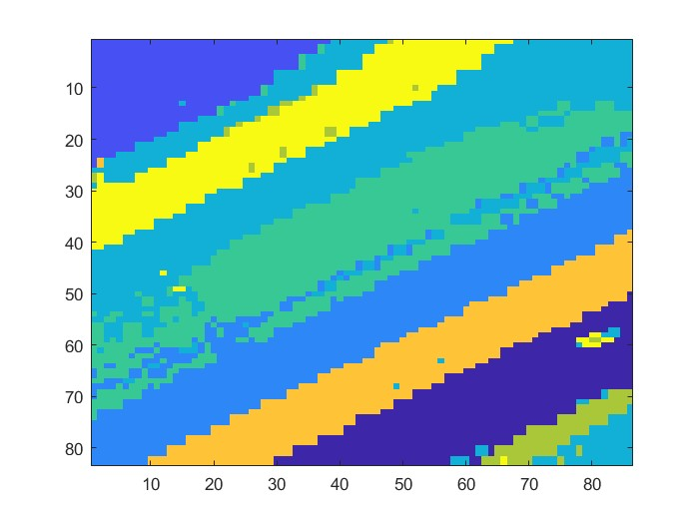
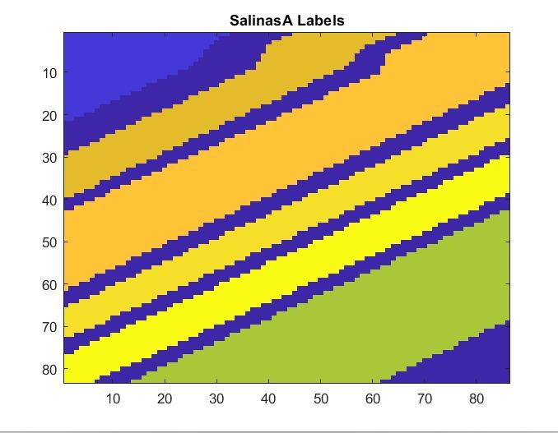
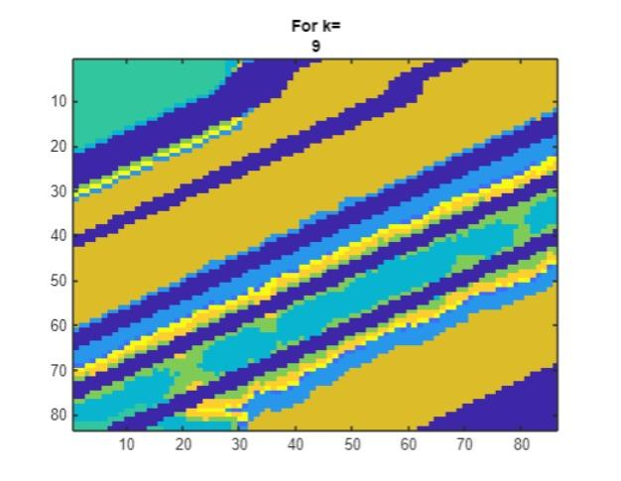
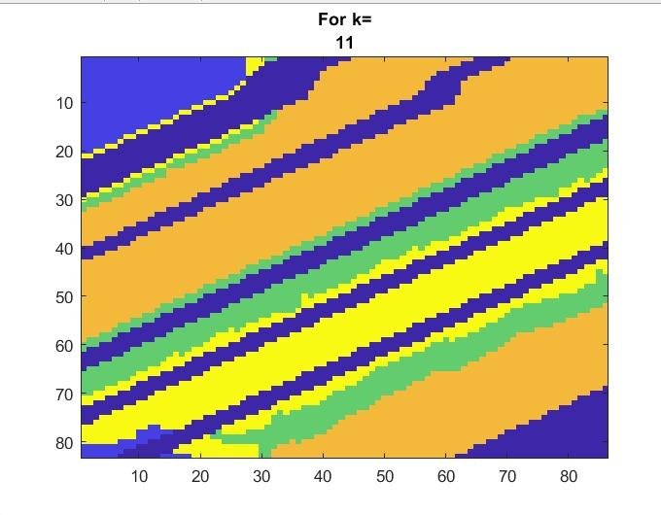
Ground truth
Predicted from FCLS
K-means
( euclidean distance)
K-means (Canberra distance)

Slide 15
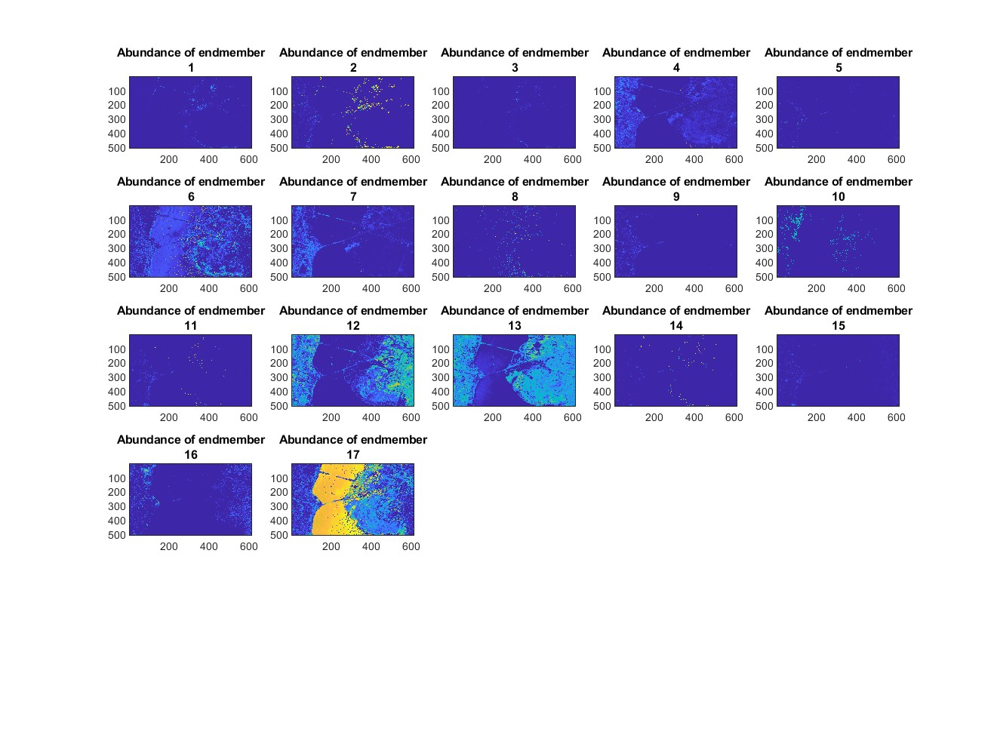
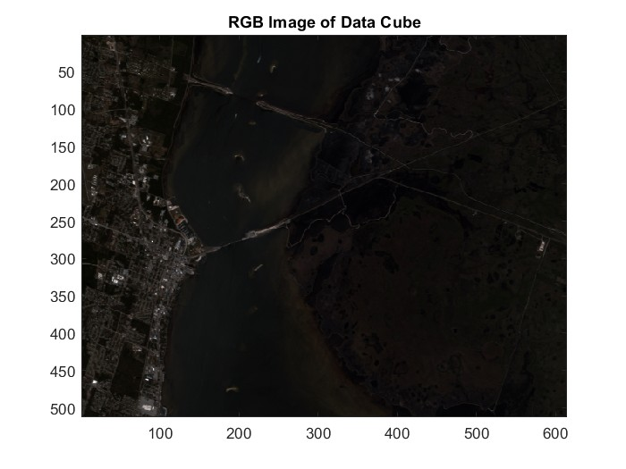
RESULTS (KSC)
End members
RGB Image

Slide 16
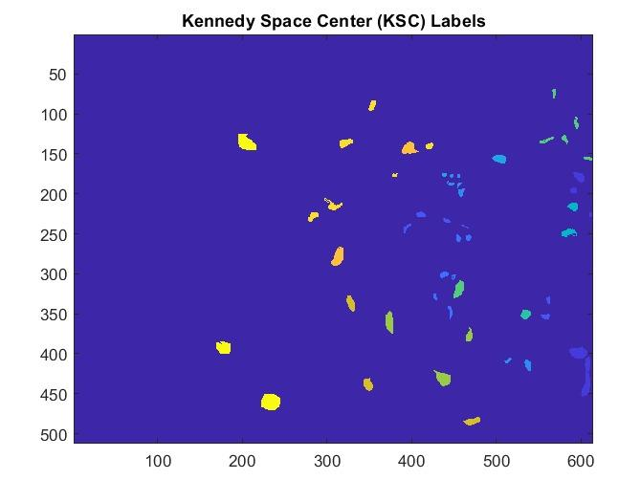
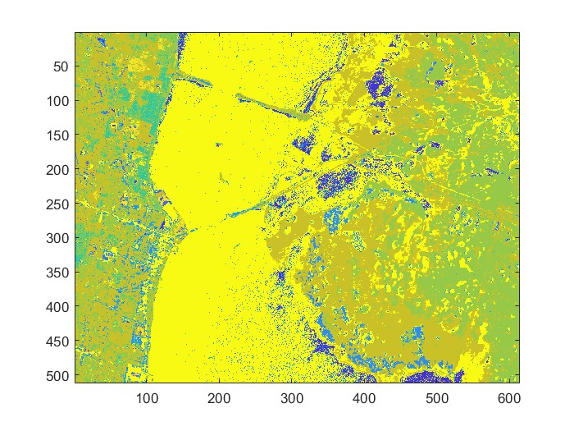
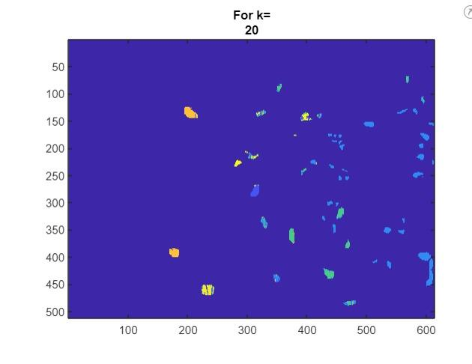
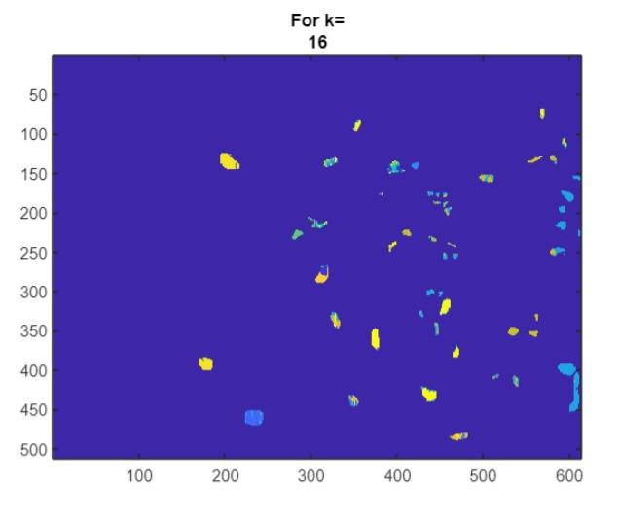
Ground truth
Predicted from FCLS
K-means
( euclidean distance)
K-means (Canberra distance)

Slide 17
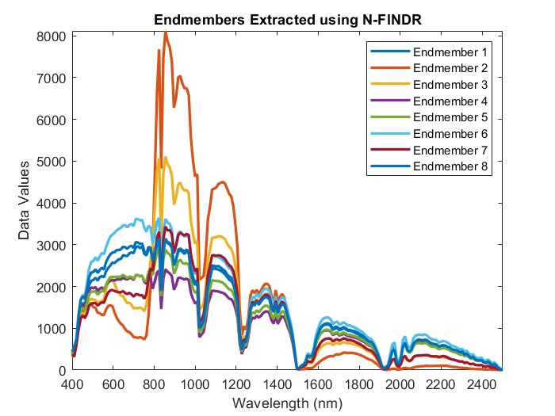
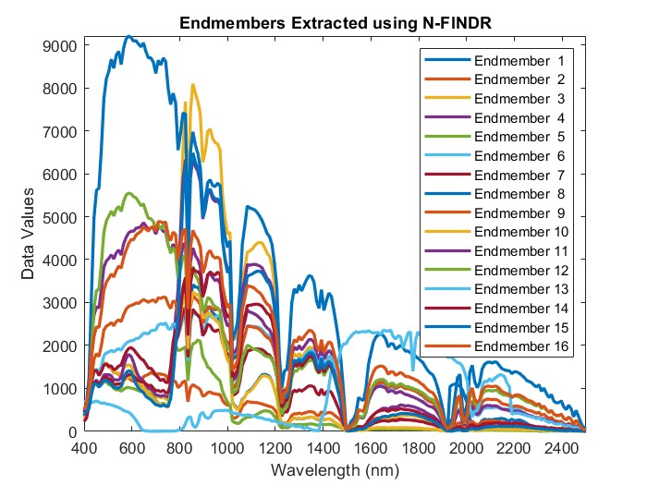
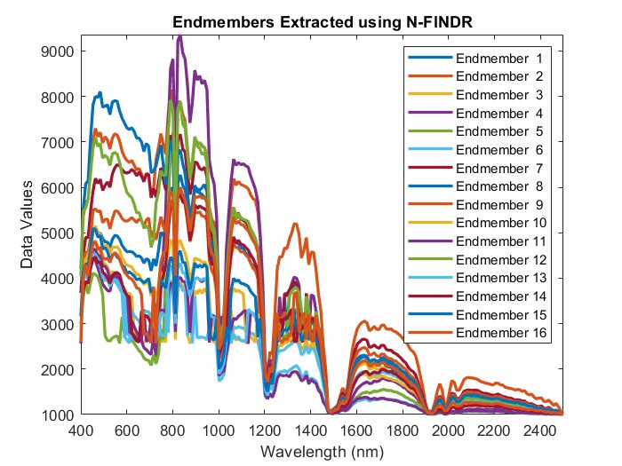
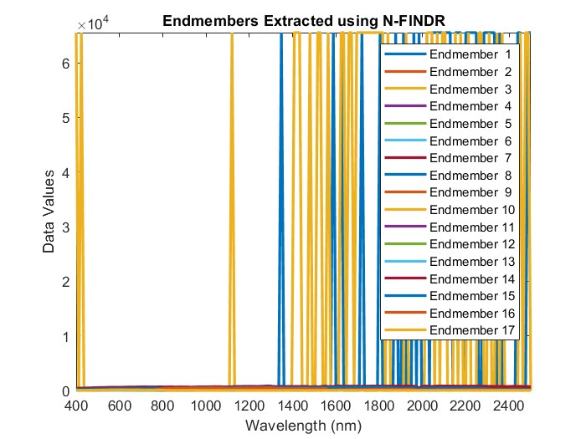
Endmembers extracted from each dataset
Salinas-A
Salinas
Indian Pines
Kennedy Space Centre

